Slide 1
Inventory Management System
// November 2021
Made by-
Nikhil Pangaonkar-35
Hrishikesh Patil-36
Nachiket Nalawade-30
Mentor- Dr. Sarika Bukkawar

Slide 2
What is inventory management ?
Inventory management is how you track and control your business’ inventory as it is bought, manufactured, stored, and used. It governs the entire flow of goods from purchasing right through to sale ensuring that you always have the right quantities of the right item in the right location at the right time.
A key function of inventory management is to keep a detailed record of each new or returned product as it enters or leaves a warehouse or point of sale.

Slide 3
Why inventory management system ?
Inventory systems tell you the number of components or ingredients you need to create or assemble your final product. Without this information you may end up with excess stock, eroding your bottom line, or with insufficient stock to meet customer demand.
Problem statement

Slide 4
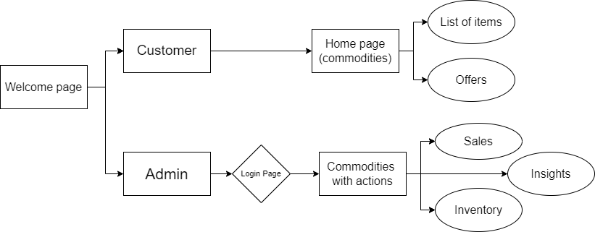
Walkthrough of the portal

Slide 5
Learning Objectives
To learn to use SQL with NodeJS and Express
To handle SQL server.
To learn SQL queries
Learn to manage a database in real life

Slide 6




Front-end design
HTML-5
CSS-3
JAVASCRIPT
BOOTSTRAP

Slide 7





Back-end design
NODE JS
EXPRESS JS
EXPRESS HANDLEBARS
MySql
XAMPP

Slide 8
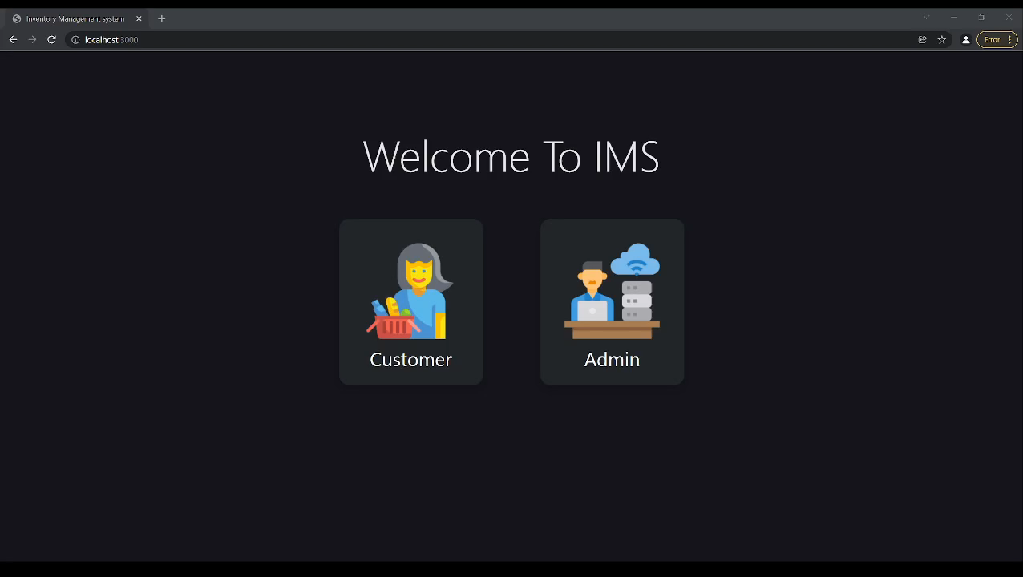
UI Representation

Slide 9
Future Enhancements
01
02
03
Working on sales page
Sales insights
UI updates

Slide 10

// Conclusion
Desktop inventory web application is ready.
Consumer-side UI is working

Slide 11
THANKS!
//Inventory Management System
Hrishikesh Patil-36
Nikhil Pangaonkar-35
Nachiket Nalawade-30

